Slide 1

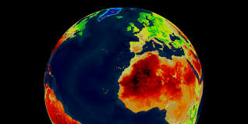
Pattern Analysis Of Earths Surface Temperature

Slide 2
Team Members
Induraj PR
Kofi Dramane
Murali Krishna Mopidevi

Slide 3

Agenda
01
Introduction To the project
What our project is about? And What it is not!
02
Data Collection techniques used in this field of climate dynamics
Brief introduction on dataset
03
04
Techniques applied in our project
05
Results and discussions
06
Further enhancements

Slide 4
INTRODUCTION
What our project is about?
Our project mainly focusses on determining the repetitive patterns in the earths surface temperature! Earths surface temperature by itself is unique and is most often confused with the earths climatic temperature!
What we intend to do in this project is find the patterns in the earths surface temperature and our intention is neither to make any debate of if it one of the key factor in global warming nor prove if global warming is hoax or real!
But at the conclusion we prove a fact that intuitively supports the researchers that global warming is hoax!

Slide 5
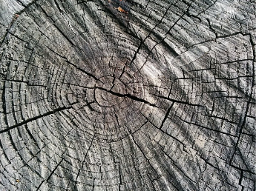
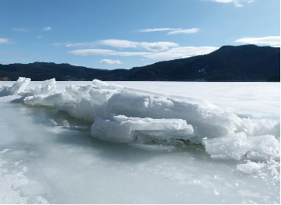
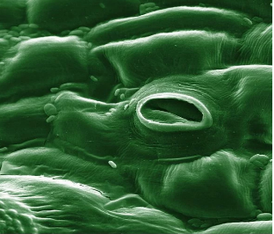
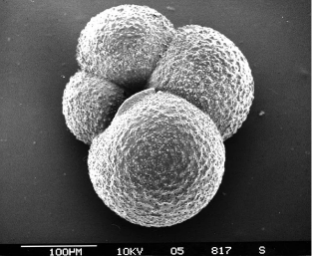
Data collection Techniques
Now-a-days
The modern instrumental temperature record could only tell us about the planet’s temperature trends over the last 150 years.
But How do scientists and researchers talk about the climatic conditions thousands or even millions of years ago?
Tree Rings
Ice Sheets
Fossil leaves
Lake and Ocean sediments

Slide 6

Brief Introduction on dataset
The earth’s surface temperature rather than exhibiting the stationary trend, it has a non-stationary trend which makes the analysis of earth’s surface temperature little more difficult!
We have non stationary time series data on earth’s surface temperature for 265 years! Dating back from 1750 to 2015
In each year, at the sampling interval of 1 month’s data’s had been recorded, so making the total number of samples to be 3192.
We rather than using the global surface temperature data categorized by cities/ countries, we have used the mean global surface temperature data

Slide 7

Techniques Applied
01
ETL
We had to clean and transform the data as the dataset had anomalies like invalid entries and NAN values!
02
Fast Fourier Transform
Fast Fourier analysis being the frequency domain representation of the actual signal, we find the dominant frequency by which we can say if there is any repetition of patterns
03
Spectrogram
A spectrogram being a visual representation of the spectrum of frequencies as it varies with time, we gain a better insight on the signal representation with respect to both time and frequency domain
04
Wavelets
We have used the MODWT- maximum overlap discrete wavelet transform for the pattern analysis.

Slide 8
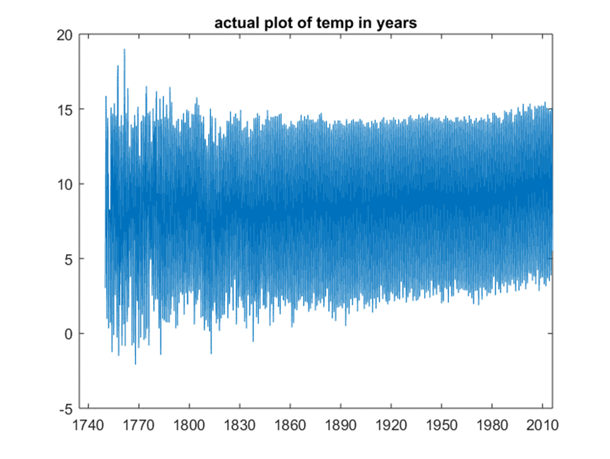
Actual plot of temp in years

Slide 9
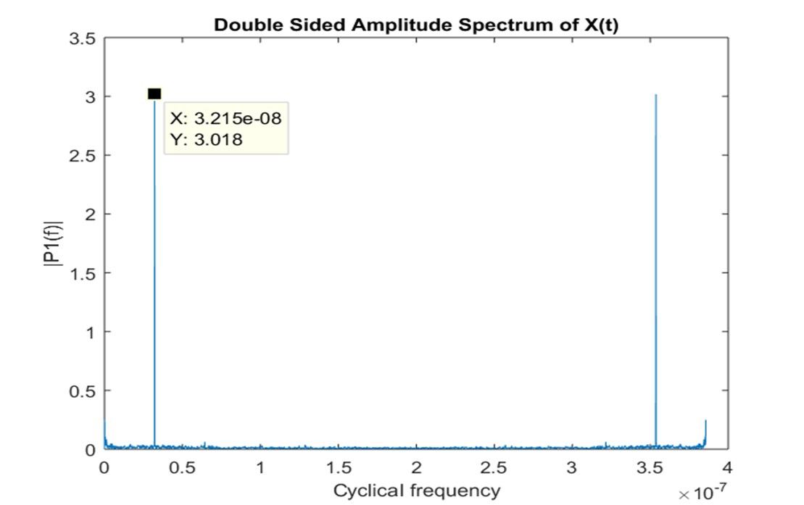
Fast Fourier Transform

Slide 10
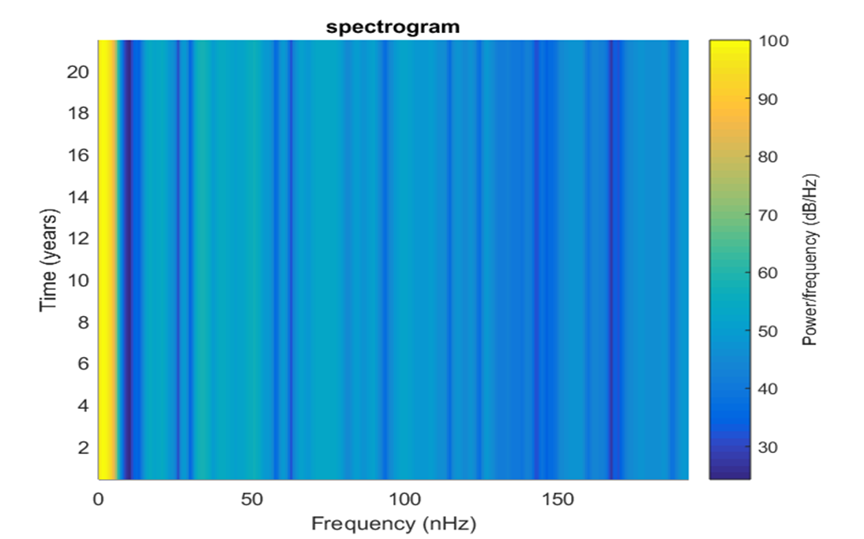
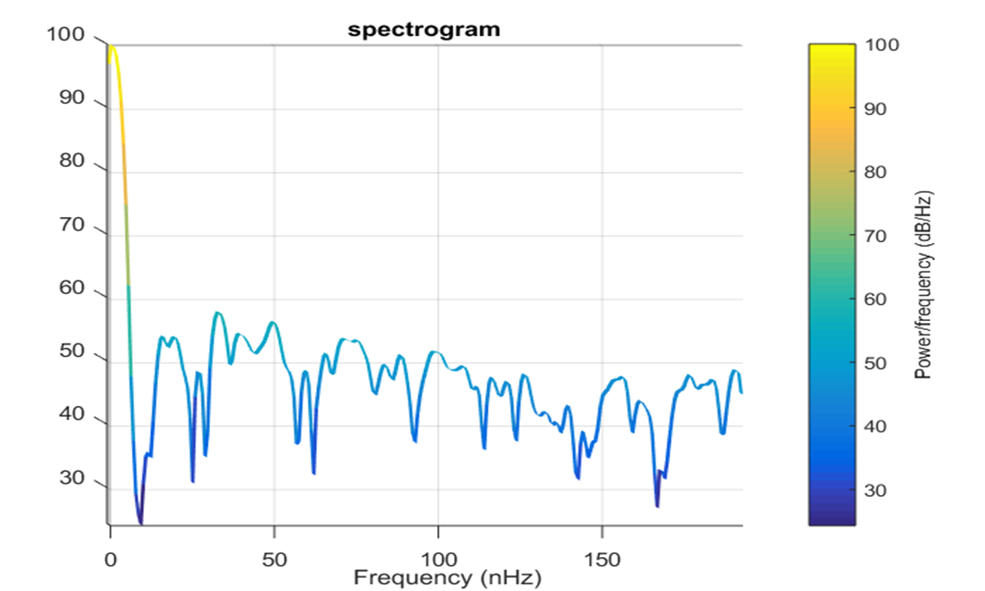
Spectrogram
Notes:
A spectrogram is a visual representation of the spectrum of frequencies of a signal as it varies with time. This is used just to get better insight on the signals frequency as it goes with time.

Slide 11
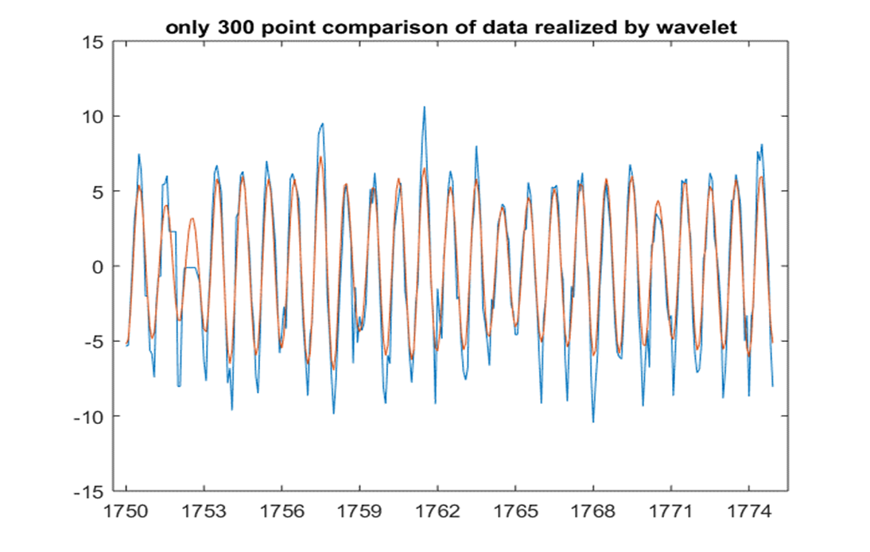
Only 300 point comparison of data realized by wavelet
Notes:
The MODWT is a non-decimated form of the discrete wavelet transform (DWT) having many advantages over the DWT including the ability to handle arbitrary length sequences and shift invariance (while the wavDWT function can handle arbitrary length sequences, it does so by means of an ad hoc storage sytem for odd length scaling coefficient crystals. The MODWT needs no such scheme and is more robust in this respect). The cost of the MODWT is in its redundancy. For an N point input sequence, there are N wavelet coefficients per scale. However, the number of multiplication operations is O(N log2(N)) which is the same as the fast Fourier transform, and is acceptably fast for most situations.

Slide 12
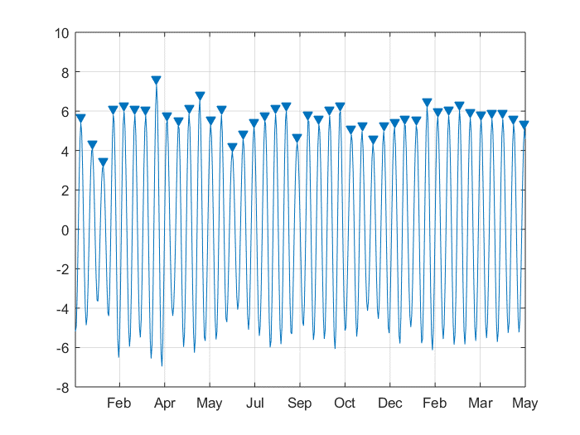
Finding patterns

Slide 13
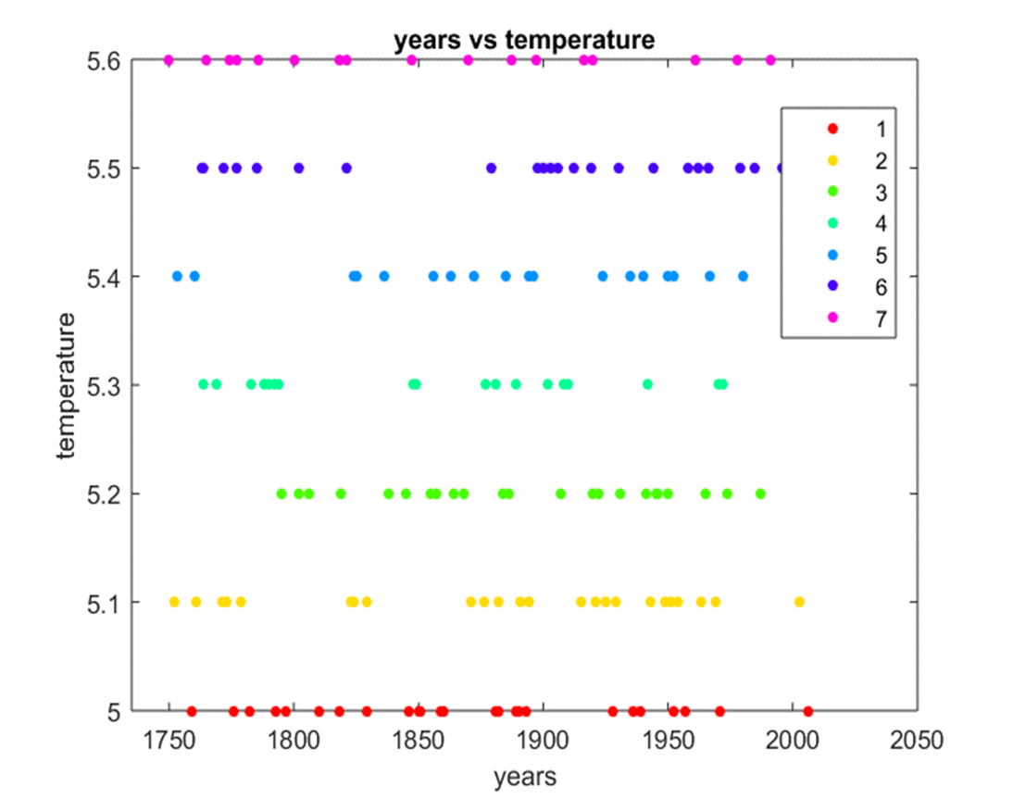
Years vs Temperature

Slide 14
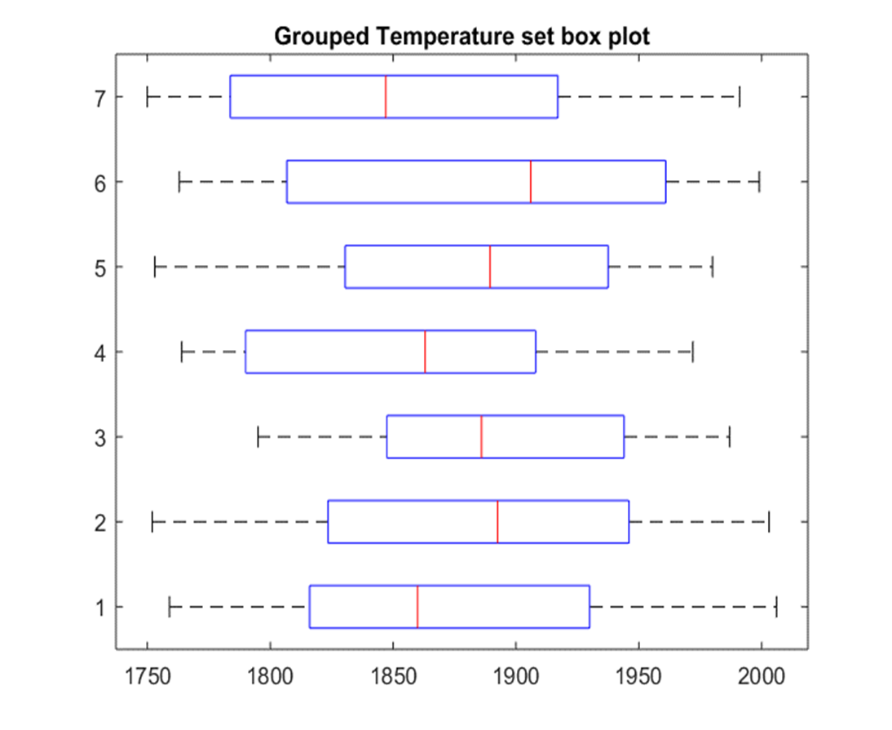
Grouped Temperature set box plot

Slide 15
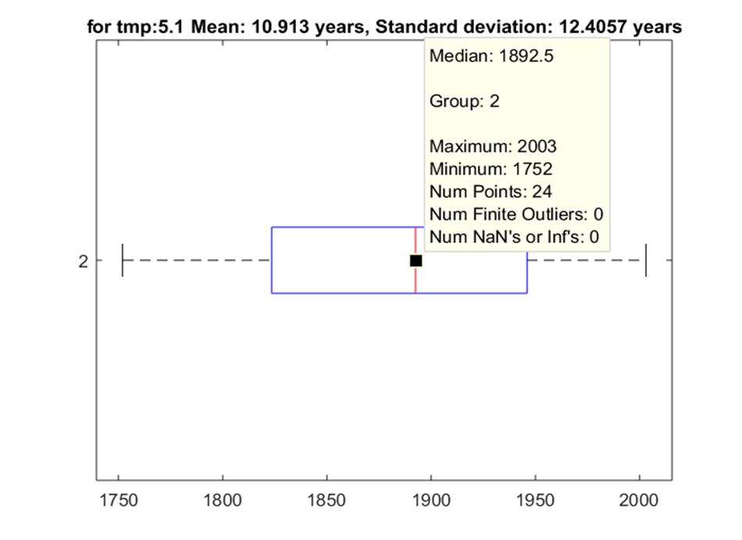
For Temp:5.1, Mean:10.913 years, Standard Deviation:12.4057 years

Slide 16
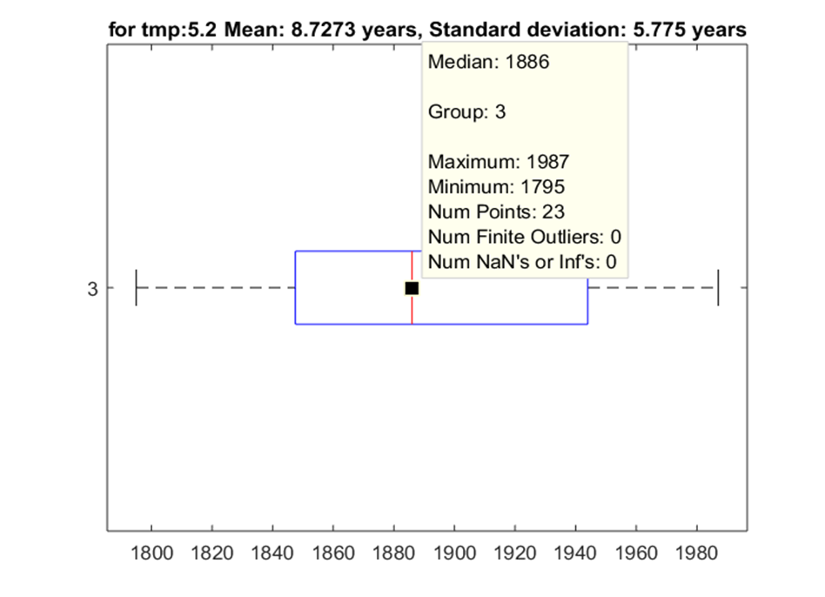
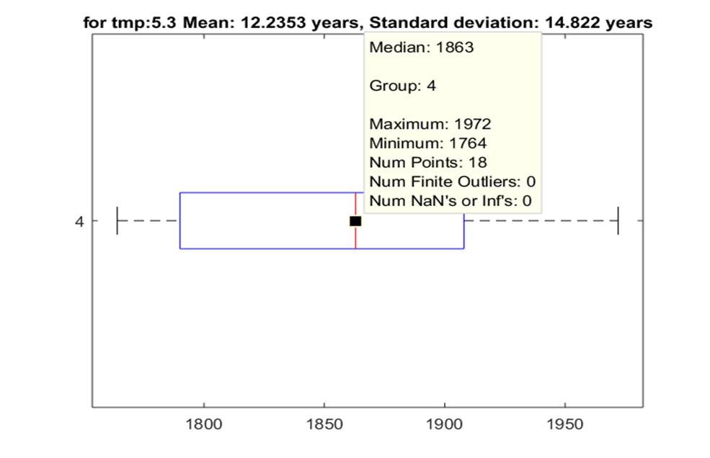

Slide 17
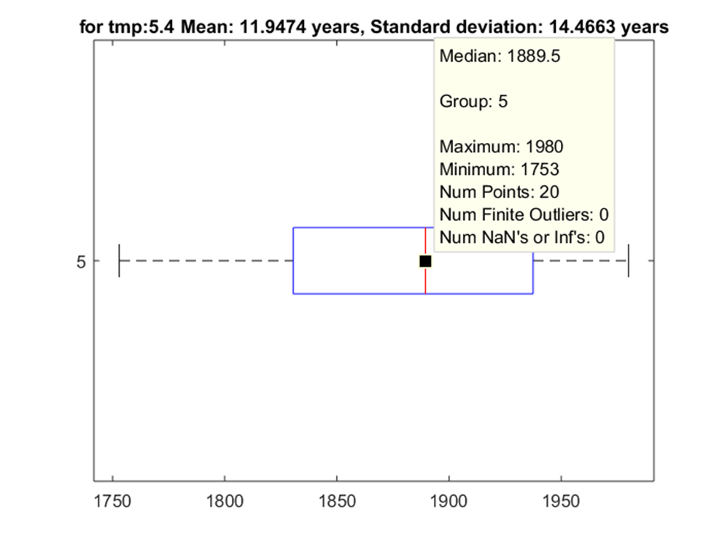
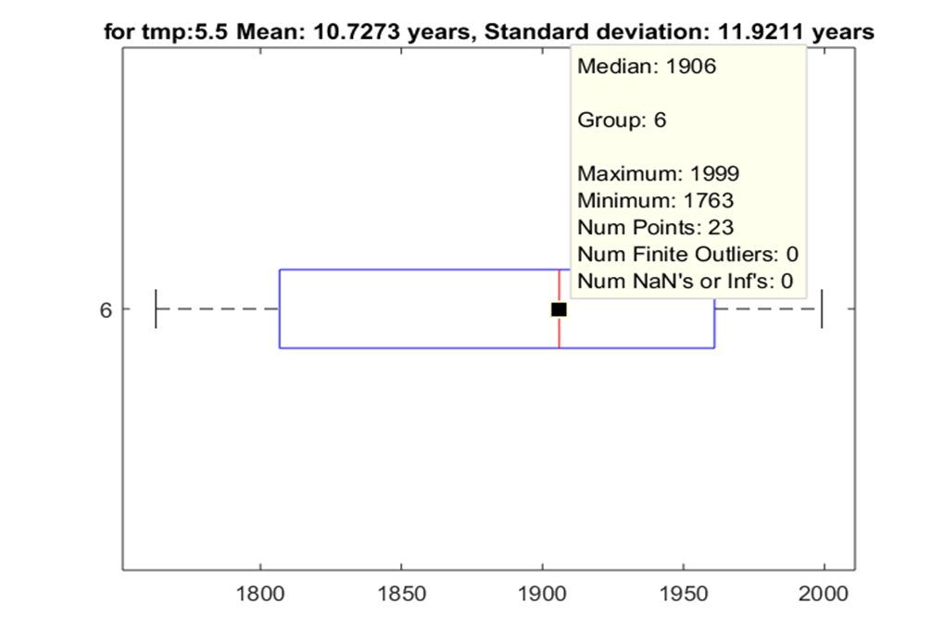

Slide 18
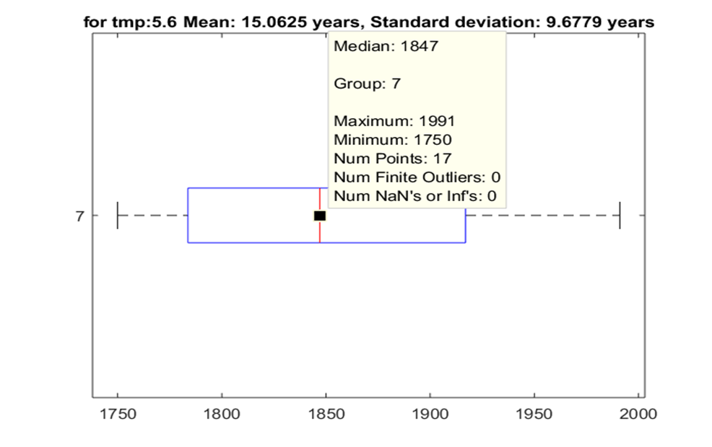
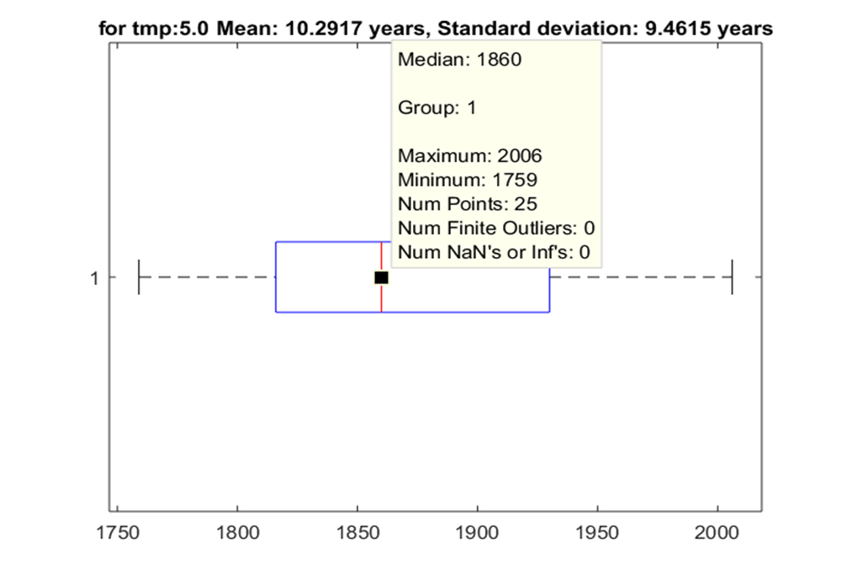
We see that the other temperature ranges never have repeated in the recent years despite their average
Mean indicate that they should have appeared in recent years!
But the only temperature which happens to appear is the Temperature corresponding to 5.0degree Celsius,
which clearly supports the facts put forth by renowned Scientist that for the past decade our earth is not
warming and global warming is a hoax!

Slide 19
Future possible enhancements
By extracting interesting frequencies, we could reconstruct the signal by inverse Fourier transform, So that the same waveform can be repeated, which can be used to reveal Some useful patterns corresponding to the future
The seasonality's and trends can be removed to perform the AR, ARMA models for better predictions of the near future

Slide 20
Thank You..!

